Slide 1
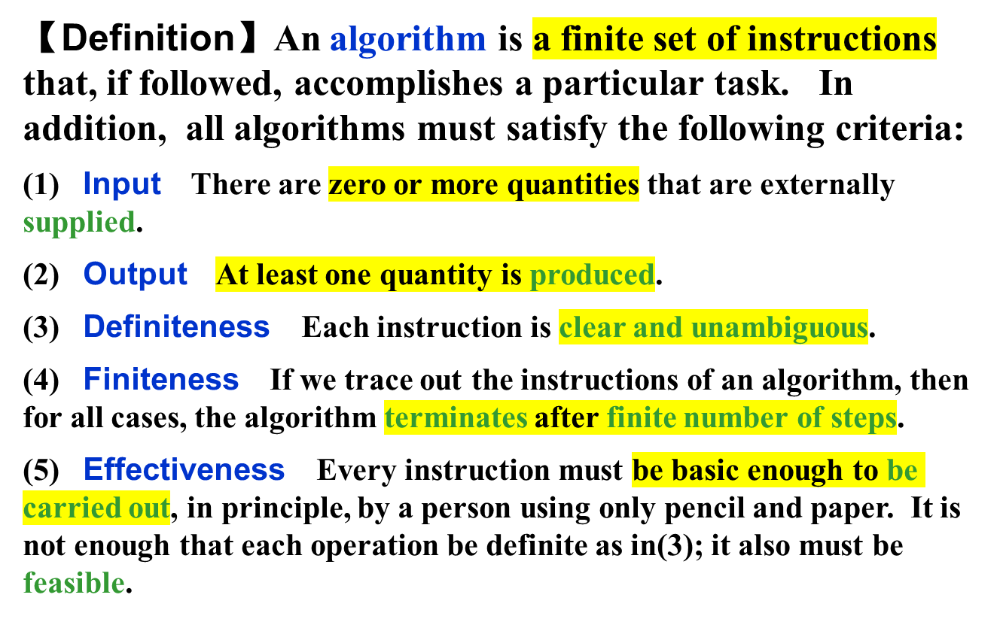
CHAPTER 2
ALGORITHM ANALYSIS
1/15

Slide 2
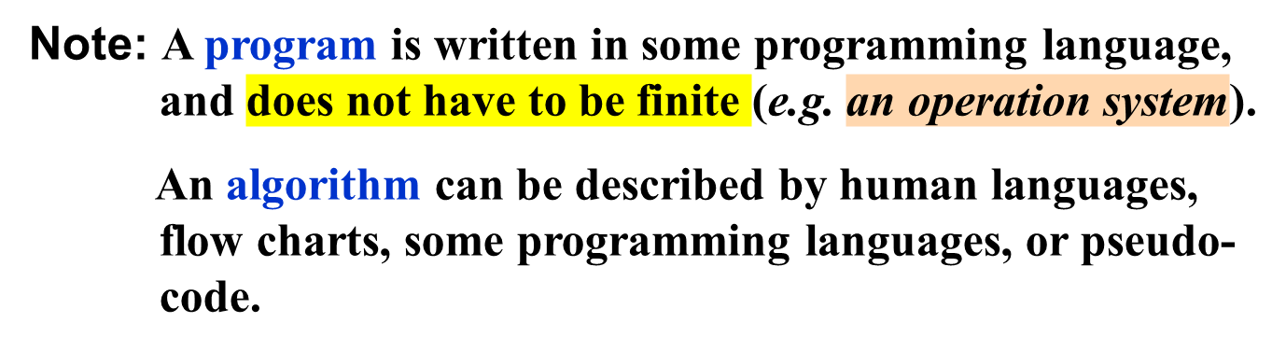
〖Example〗 Selection Sort: Sort a set of n ≥ 1 integers in increasing order.
From those integers that are currently unsorted, find the smallest and place it next in the sorted list.
Where and how
are they stored?
for ( i = 0; i < n; i++) {
Examine list[i] to list[n−1] and suppose that the smallest integer is at list[min];
Interchange list[i] and list[min];
}
Where?
Algorithm in
pseudo-code
Sort = Find the smallest integer + Interchange it with list[i].
2/15

Slide 3
§1 What to Analyze
➢ Machine & compiler-dependent run times.
➢ Time & space complexities : machine & compiler-independent.
Assumptions:
① instructions are executed sequentially
② each instruction is simple, and takes exactly one time unit
③ integer size is fixed and we have infinite memory
Typically the following two functions are analyzed:
T_{avg}(N) & T_{worst}(N) -- the average and worst case time complexities, respectively, as functions of input size N.
If there is more than one input, these functions may have more than one argument.
3/15

Slide 4
§1 What to Analyze
〖Example〗 Matrix addition
void add ( int a[ ][ MAX_SIZE ],
int b[ ][ MAX_SIZE ],
int c[ ][ MAX_SIZE ],
int rows, int cols )
{
int i, j ;
for ( i = 0; i < rows; i++ )
for ( j = 0; j < cols; j++ )
c[ i ][ j ] = a[ i ][ j ] + b[ i ][ j ];
}
Q: What shall we do
if rows >> cols?
A: Exchange
rows and cols.
/* rows + 1 */
/* rows(cols+1) */
/* rows ⋅ cols */
T(rows, cols ) = 2 rows ⋅ cols + 2rows + 1
4/15

Slide 5
§1 What to Analyze
float sum ( float list[ ], int n )
{ /* add a list of numbers */
float tempsum = 0;
int i ;
for ( i = 0; i < n; i++ )
tempsum += list [ i ] ;
return tempsum;
}
〖Example〗Iterative function for summing a list of numbers
/* count = 1 */
/* count ++ */
/* count ++ */
T_{sum} ( n ) = 2n + 3
/* count ++ for last execution of for */
/* count ++ */
〖Example〗Recursive function for summing a list of numbers
float rsum ( float list[ ], int n )
{ /* add a list of numbers */
if ( n )
return rsum(list, n−1) + list[n − 1];
return 0;
}
/* count ++ */
T_{rsum} ( n ) = 2n + 2
But it takes more time to compute each step.
/* count ++ */
/* count ++ */
5/15

Slide 6

§1 What to Analyze
Take the iterative and
recursive programs for summing
a list for example --- if you think 2n+2 is
less than 2n+3, try a large n and
you’ll be surprised !
I see ...
Then what’s the point of
this T_{p} stuff?
So it’s too complicated sometimes.
But does it worth the effort?
Is it really necessary
to count the exact
number of steps ?
Uhhh ...
I don’t think so.
Good question !
Let’s ask the students ...
Because
it drives me crazy!
Why?
6/15

Slide 7

§2 Asymptotic Notation ( Ο, Ω, Θ, o )
The point of counting the steps is to predict the growth in run time as the N change, and thereby compare the time complexities of two programs. So what we really want to know is the asymptotic behavior of T_{p}.
Suppose T_{p1} ( N ) = c₁N² + c₂N and T_{p2} ( N ) = c₃N. Which one is faster?
No matter what c₁, c₂, and c₃ are, there will be an n₀ such that T_{p1} ( N ) > T_{p2} ( N ) for all N > n₀.
I see! So as long as I know that
T_{p1} is about N² and T_{p2} is about N, then for
sufficiently large N, P2 will be faster!
7/15

Slide 8
§2 Asymptotic Notation
【Definition】 T (N) = O( f (N) ) if there are positive constants c and n₀ such that T (N) ≤ c ⋅ f (N) for all N ≥ n₀.
【Definition】 T (N) = Ω( g(N) ) if there are positive constants c and n₀ such that T (N) ≥ c ⋅ g(N) for all N ≥ n₀.
【Definition】 T (N) = Θ( h(N) ) if and only if T (N) = O( h(N) ) and T (N) = Ω( h(N) ) .
【Definition】 T (N) = o( p(N) ) if T (N) = O( p(N) ) and T (N) ≠ Θ( p(N) ) .
Note:
➢ 2N + 3 = O( N ) = O( N^{k≥1} ) = O( 2^{N} ) = ⋅⋅⋅ We shall always take the smallest f (N).
➢ 2^{N} + N² = Ω( 2^{N} ) = Ω( N² ) = Ω( N ) = Ω( 1 ) = ⋅⋅⋅ We shall always take the largest g(N).
8/15

Slide 9


§2 Asymptotic Notation
Rules of Asymptotic Notation
☞ If T₁ (N) = O( f (N) ) and T₂ (N) = O( g(N) ), then
(a) T₁ (N) + T₂ (N) = max( O( f (N)), O( g(N)) ),
(b) T₁ (N) * T₂ (N) = O( f (N) * g(N) ).
☞ If T (N) is a polynomial of degree k, then T (N) = Θ( N ^{k} ).
☞ log^{k} N = O(N) for any constant k. This tells us that logarithms grow very slowly.
Note: When compare the complexities of two programs asymptotically, make sure that N is sufficiently large.
For example, suppose that T_{p1} ( N ) = 10⁶N and T_{p2} ( N ) = N². Although it seems that Θ( N² ) grows faster than Θ( N ), but if N < 10⁶, P2 is still faster than P1.
9/15

Slide 10

§2 Asymptotic Notation
10/15

Slide 11

§2 Asymptotic Notation
2^{n}
n²
n log n
f
n
Log n
n
11/15

Slide 12

§2 Asymptotic Notation
n
μs = microsecond = 10⁻⁶ seconds
ms = millisecond = 10⁻³ seconds
sec = seconds
min = minutes yr = years
hr = hours
d = days
12/15

Slide 13
§2 Asymptotic Notation
〖Example〗 Matrix addition
void add ( int a[ ][ MAX_SIZE ],
int b[ ][ MAX_SIZE ],
int c[ ][ MAX_SIZE ],
int rows, int cols )
{
int i, j ;
for ( i = 0; i < rows; i++ )
for ( j = 0; j < cols; j++ )
c[ i ][ j ] = a[ i ][ j ] + b[ i ][ j ];
}
/* Θ (rows) */
/* Θ (rows ⋅ cols ) */
/* Θ (rows ⋅ cols ) */
T(rows, cols ) = Θ (rows ⋅ cols )
13/15

Slide 14
§2 Asymptotic Notation
General Rules
☞ FOR LOOPS: The running time of a for loop is at most the running time of the statements inside the for loop (including tests) times the number of iterations.
☞ NESTED FOR LOOPS: The total running time of a statement inside a group of nested loops is the running time of the statements multiplied by the product of the sizes of all the for loops.
☞ CONSECUTIVE STATEMENTS: These just add (which means that the maximum is the one that counts).
☞ IF / ELSE: For the fragment
if ( Condition ) S1;
else S2;
the running time is never more than the running time of the test plus the larger of the running time of S1 and S2.
14/15

Slide 15

§2 Asymptotic Notation
☞ RECURSIONS:
〖Example〗 Fibonacci number:
Fib(0) = Fib(1) = 1, Fib(n) = Fib(n−1) + Fib(n−2)
long int Fib ( int N )
{
if ( N <= 1 )
return 1;
else
return Fib( N − 1 ) + Fib( N − 2 );
}
/* T ( N ) */
Q: Why is it
so bad?
/* O( 1 ) */
/* O( 1 ) */
/*O(1)*/
/*T(N −1)*/
/*T(N −2)*/
T(N) = T(N −1) + T(N −2) + 2
≥ Fib(N)
Proof by induction
T(N) grows exponentially
15/15

